Slide 1

Smarticle – Demo 4

Slide 2
Our Team:
Amit Finzi
Rawad AbuSaleh
Yael Noyman
Shalev Roimi
Anas Khader Mhameed

Slide 3
Description of the application:
Smarticle is a social network intended to share knowledge through blogs posts.
Each user can write his own article on his desired subject and share his knowledge.
We believe in the freedom of expression and would like to give users the ability sharing their thoughts and experiences.

Slide 4
Architecture
The project's architecture is MVT (Django's MVC).
When making a django app we divide our app to 3 designed patterns.
Model - managing the data and the links to DB.
View - the API/controller that links the data and the UI and respond to clients requests.
Template - html parts responsible what the clients see.

Slide 5
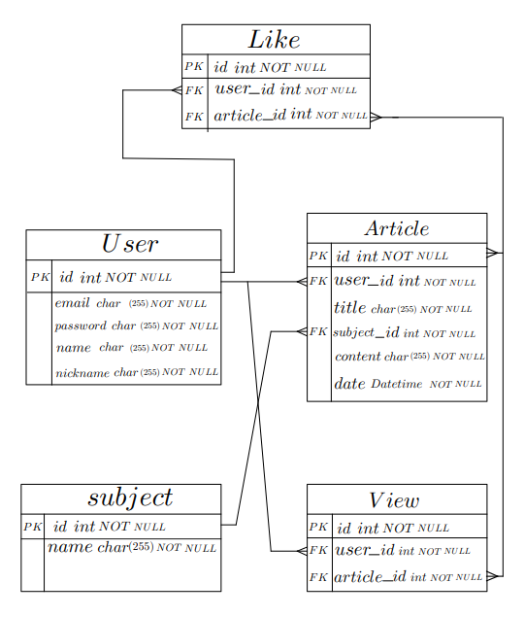
ERD

Slide 6
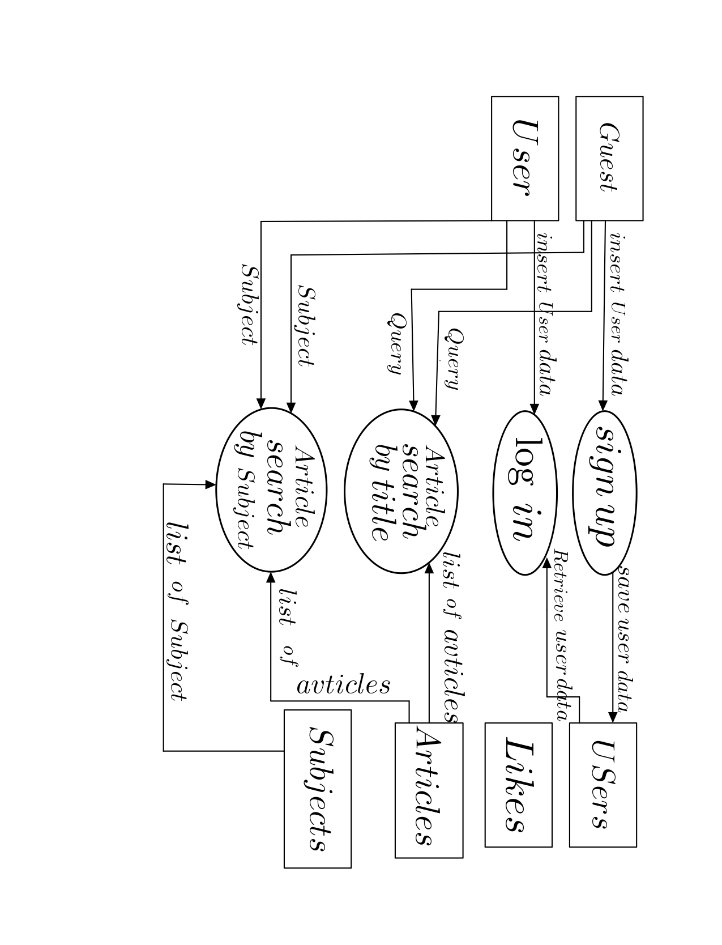
DFD

Slide 7
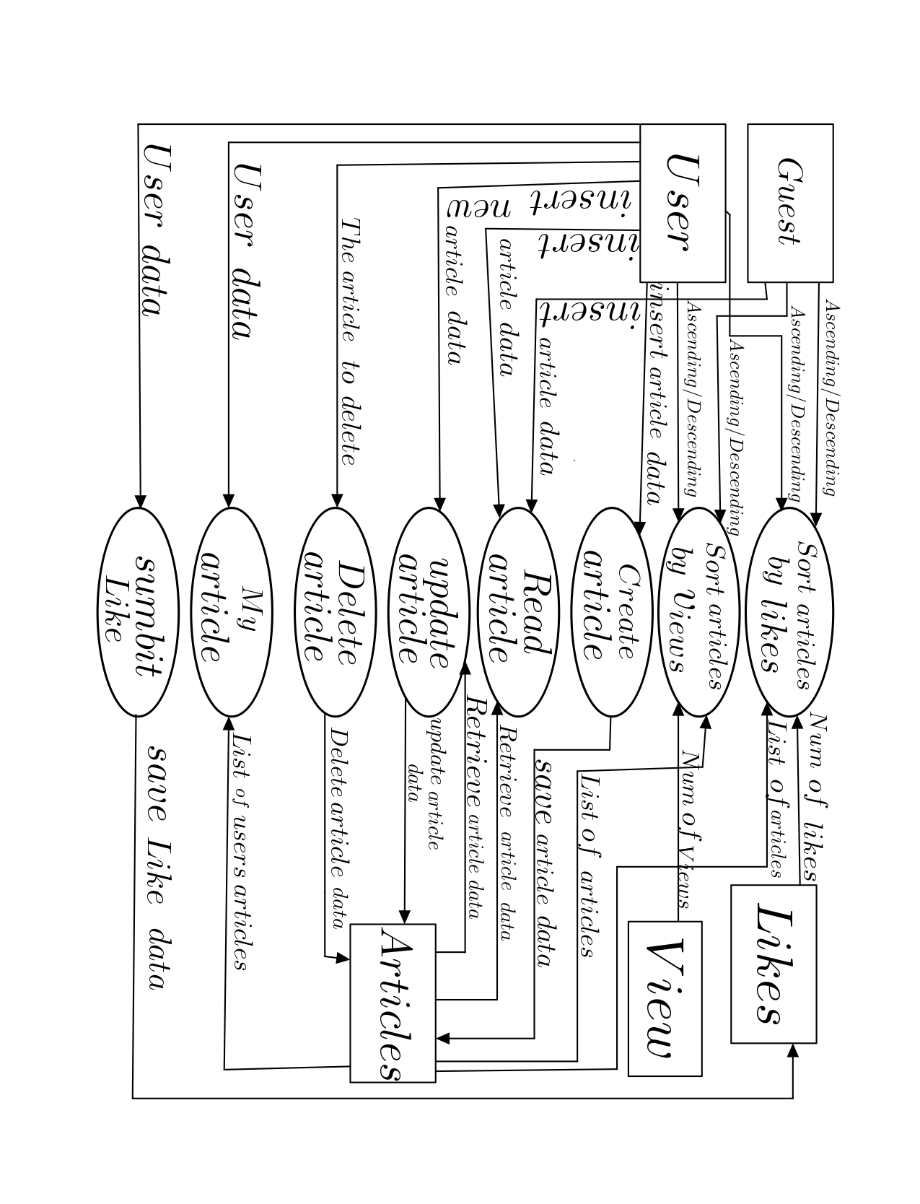
DFD

Slide 8
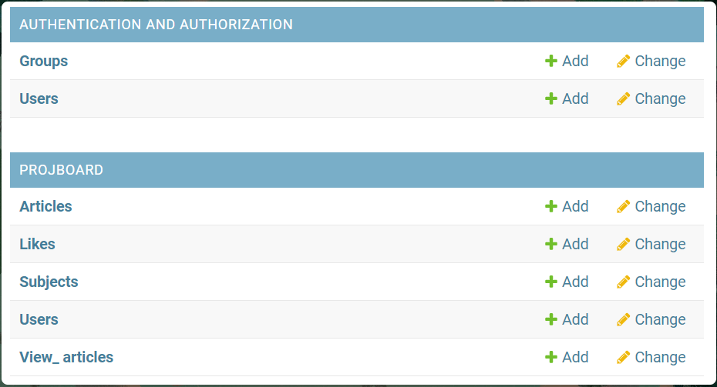
DB

Slide 9
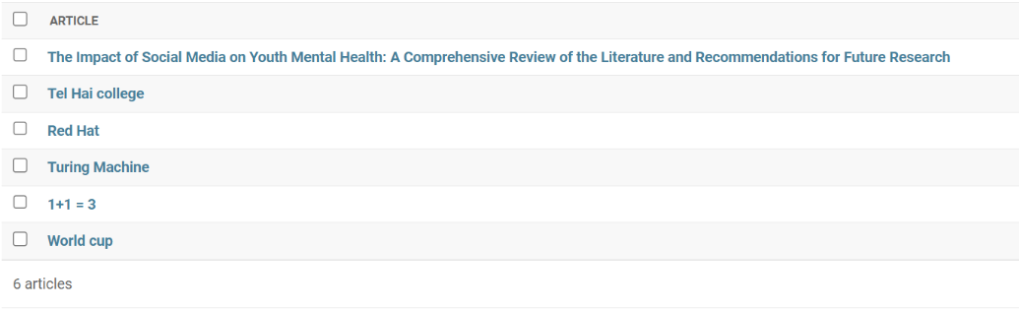
Articles

Slide 10
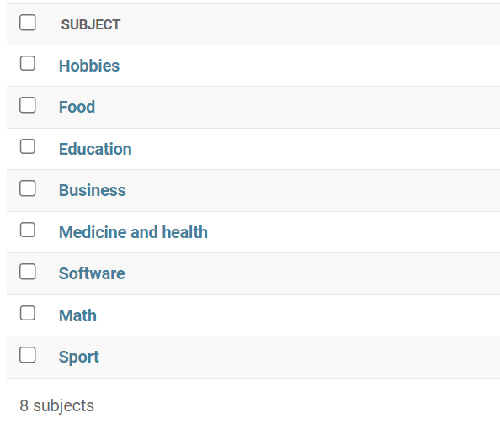
Subjects

Slide 11
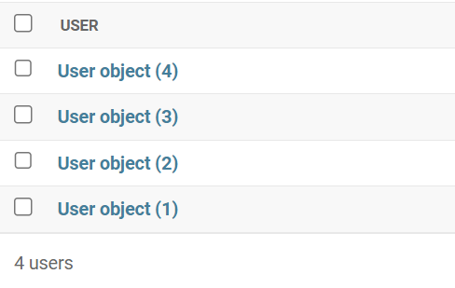
Users

Slide 12
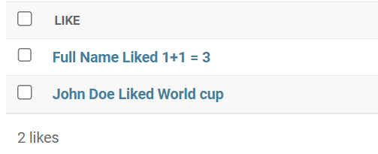
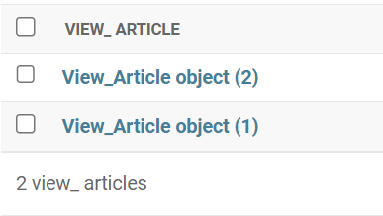
Likes and Views

Slide 13
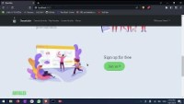
Features Demo using our UI

Slide 14
Development process:
Our work division main idea was to let each one of us few features to work on with a reasonable volume of work and more importantly having the least conflicts we can.
We helped each other and communicated all way long and had a meeting every Tuesday evening.

Slide 15
The concept was to open small issues to minimize our PRs.
For major features, we worked more than one team member on the same feature/branch.

Slide 16
About the tests
In the tests we wanted to make sure the app won't crash and would know how to handle not only normal use but also edge cases. For example we wanted to make sure every page loads up properly (for normal use), searching for article that doesn't exist or searching for articles without any search content (for edge cases).
https://github.com/redhat-beyond/Smarticle/tree/main/projboard/tests

Slide 17
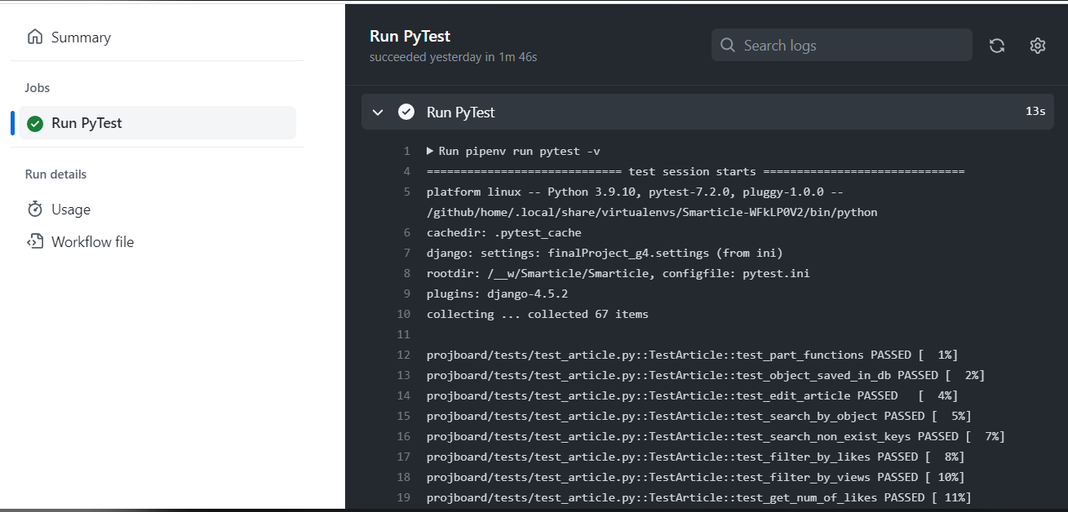
A demonstration of tests being run in GitHub actions
MODEL
CLIENT

Slide 18
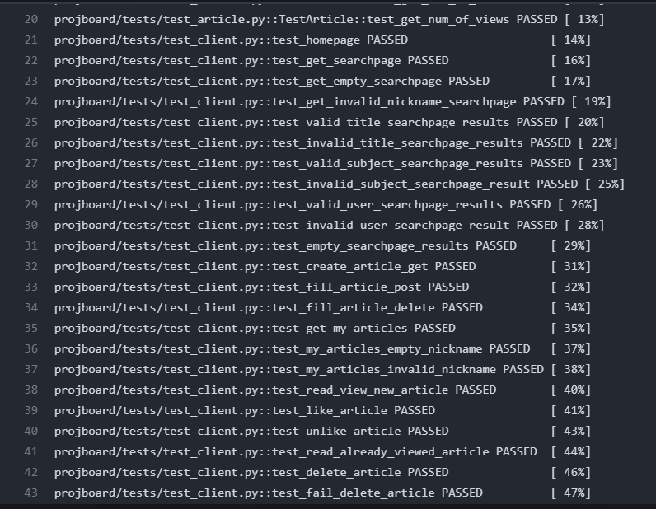
model
view

Slide 19
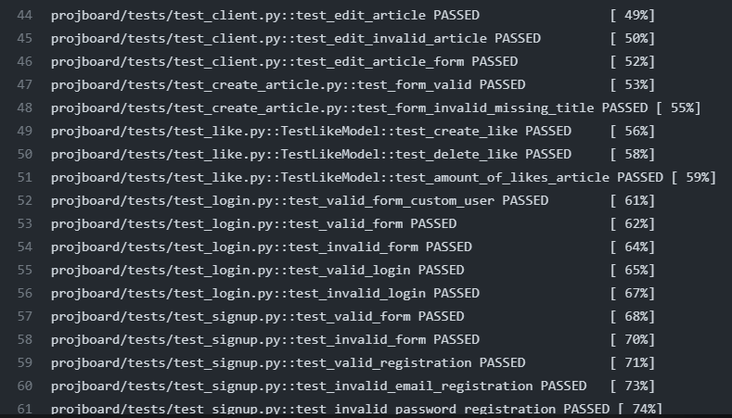
model
view

Slide 20
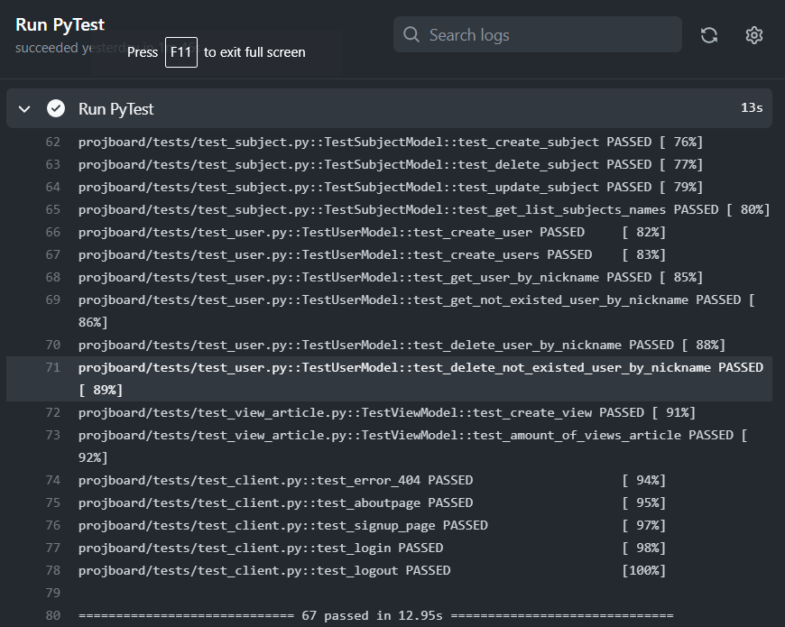

Slide 21
Individuals experience and development challenges

Slide 22
Questions?

